Slide 1
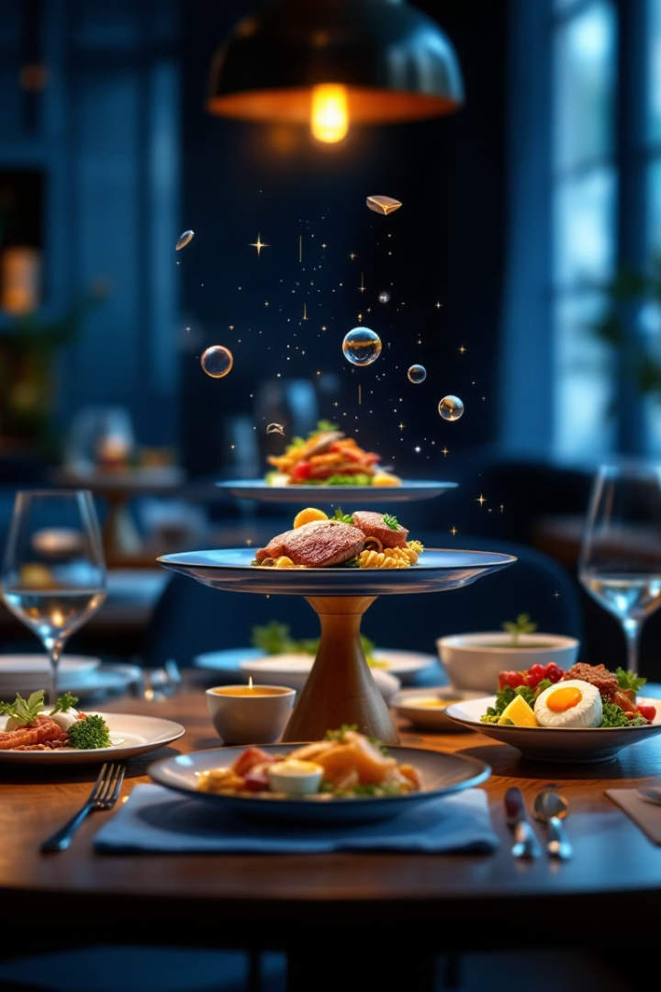

Introducing the AR Menu Card
Revolutionizing dining through Augmented Reality. Visualize food like never before. Enhancing customer experience with immersive technology.
by
Jagan T (23CSL06)
Anandha Krishnan S(23CS072)
Soorya S (23CS116)

Slide 2

The Problem: Menu Misinterpretations
Static Menus
Offer limited visualization of dishes.
Mismatched Expectations
Names and photos often confuse diners.
Customer Frustration
Leads to dissatisfaction and order errors.
Staff Challenges
Need to clarify orders frequently.

Slide 3
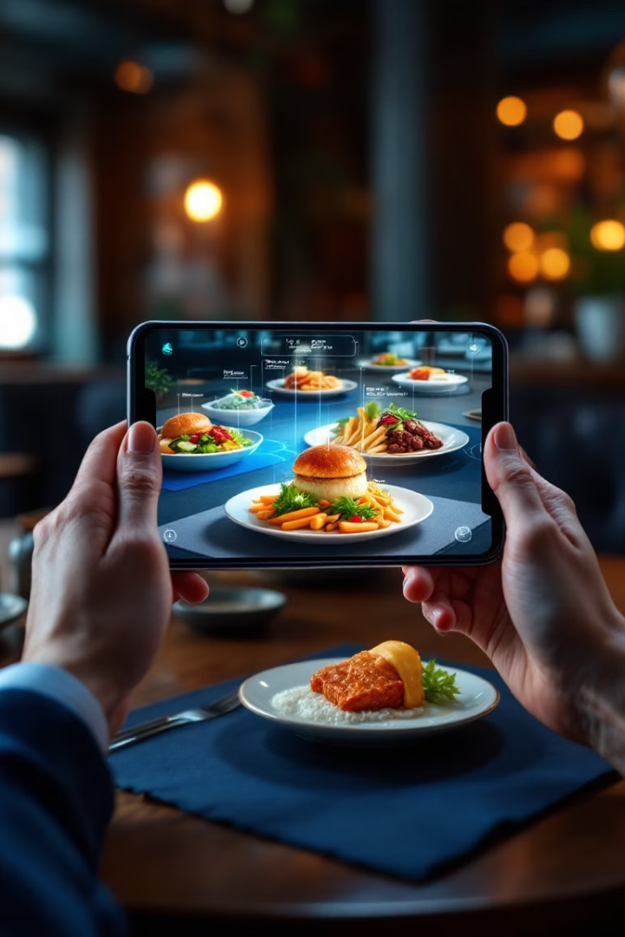
Visualizing the Solution: Augmented Reality
AR Brings Menus to Life
Interactive 3D Food Models
Showcased right on the dining table.
Easy to Use
Simply scan the card with a smartphone.

Slide 4




Enhanced Customer Engagement
Clear Visuals
Customers see exactly what they order.
Immersive Experience
Creates excitement and anticipation.
Innovative
Modern technology impresses guests.

Slide 5
Benefits for Restaurants
Order Accuracy
Showcase Dishes
Upselling & Customization
Competitive Edge
Reduce mistakes and enhance satisfaction.
Highlight food appeal with 3D visuals.
Stand out with cutting-edge tech.
Encourage customers to try add-ons.

Slide 6
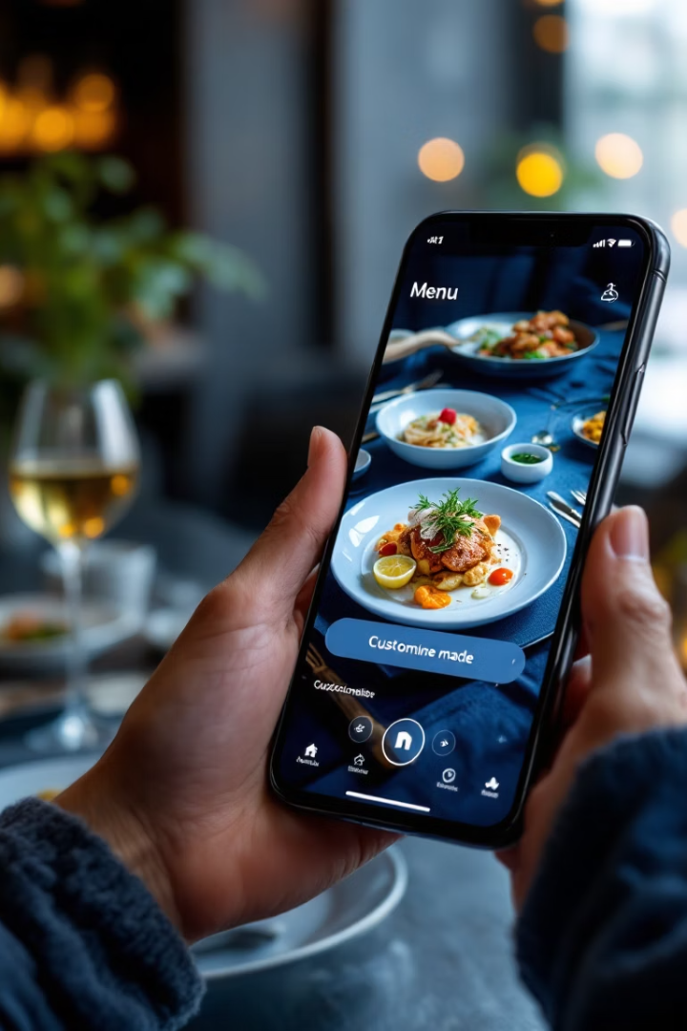




How it Works
Access
Use app or web AR without installation.
Scan
Scan the AR menu card with smartphone.
View
3D food models appear on the table.
Order
Customize and confirm your meal selection.

Slide 7
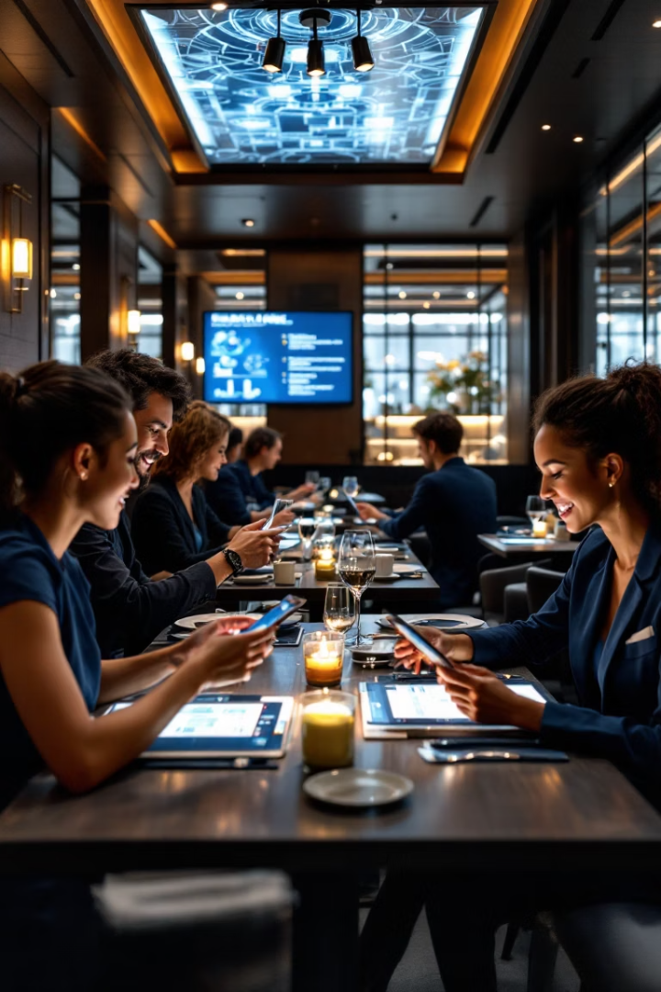
The Future of Dining is Here
Engage Customers
Boost satisfaction and excitement.
Reduce Mistakes
Clear visuals cut misunderstandings.
Enhance Experience
Make dining interactive and fun.
Get Started
Contact us to implement AR today.

Slide 8
Thank
you…!✌️

